Slide 1
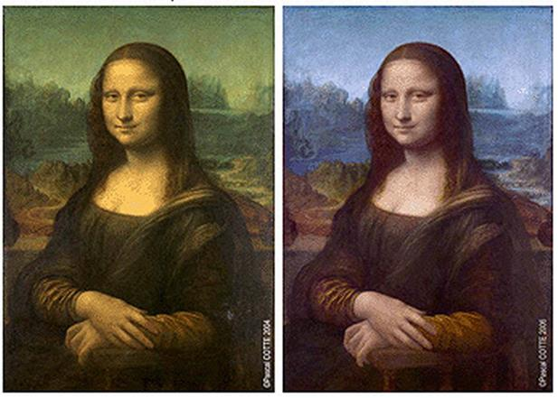

The Mathematical Image Processing of masterpieces
Stephany Palmer

Slide 2
Artistic application of mathematical image Processing
Art Restoration &
Conservation
True conservation calls for the preservation of the object to stop material decay and delay further restoration as long as possible.
Mathematical Image
Processing
The digital processing of an image to correct for visual imperfections in the least visually distracting way.

Slide 3
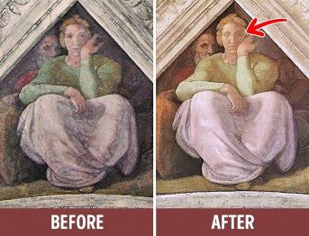
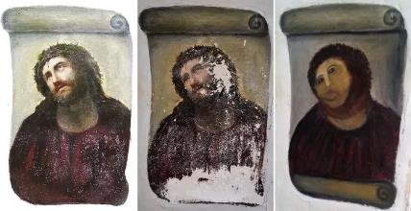
Past methods of art restoration & Conservation
Same as today
Methods:
Surface dirt removal
Varnish removal
Consolidation
Structural treatments
Inpainting
Potential Problems:
Overpainting
Unfaithful to origin

Slide 4
Multidisciplinary Modern techniques

Slide 5
Basics techniques
Main objective of art restoration and conservation is reversibility.
Digital Recoloration
Image inpainting – filling in damaged areas in an image defined on a rectangular domain by transferring the information available in the intact areas of the image to the damaged areas in the image.

Slide 6
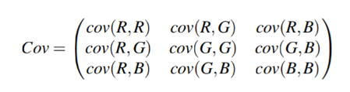
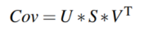

Example based Recoloration approach- Digital Restoration of Old Paintings (Arora, Kumar, and Kalra)
How to match the color space of two paintings to give clean appearance to the old painting using a statistics-based method.
First, calculate the mean of pixel data along all three axes R, G and B for both the old and sample cleaned painting, denoted as (${\overline{R}}_{old}$, ${\overline{G}}_{old}$, ${\overline{B}}_{old}$) and (${\overline{R}}_{clean}$, ${\overline{G}}_{clean}$, ${\overline{B}}_{clean}$) respectively.
Then calculate the covariance matrices for both the paintings ${Cov}_{old} and {Cov}_{clean}$.
Now, decompose the covariance matrix using singular value decomposition to get U and S.
Notes:
The paper “ Digital restoration of old paintings” describes recoloring an old painting based on the color space/coloration of a clean sample painting using statistics and matrix manipulations.
Covariance is a measure of how much two random variables vary together, instead of variance which is just how the varying of an x relates to a y.
SVD is an algorithm to decompose one complicated matrix with many variables or factors into 3 other matrices.

Slide 7
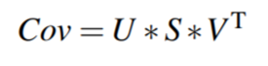
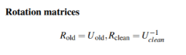
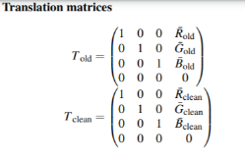
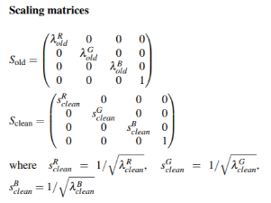

U and V are unitary matrices and are composed of eigenvectors of covariance matrix.
S is a diagonal matrix of eigenvalues of Cov, S = diag${\text{(}\text{λ}}^{R},{\text{λ}}^{G},$ ${\text{λ}}^{B}$) .
The final transformation will have the following form:
Notes:
A unitary matrix is a matrix whose inverse equals its conjugate transpose
It is complete & square.
Here are the matrices used for future transformations
Where… denote the homogeneous coordinates of pixel points for the result and old paintings respectively. This transformation is applied to each pixel of the old painting

Slide 8
The Kullback–Leibler divergence as a metric for similarity
Notes:
We need to be able to quantifiably measure how faithful or similar the digitally restored or chemically cleaned results are to the original painting for quality assurance, one method used is finding the Kullback-liebler divergence between the result and the original.

Slide 9
Similarity Metric
Use KL-divergence values to find out the relative entropy between two color distributions.
In order to assess if the new sample painting has similar color distribution to the old painting, perform eigen-space transformation followed by KL-divergence calculation.

Slide 10
Definition of the Kullback–Leibler divergence
The Kullback-Leibler divergence is a non-symmetric measure of the difference between two probability distributions P and Q. KL measures the expected number of extra bits required to code samples from P when using a code optimized Q, rather than using a code based on P. With P being the observed distribution of data; Q approximating P.

Slide 11
Using KL Divergence
Recap:
Calculate the mean of pixel data along the three axes and compute the covariance matrices between the three components in the color space for both the given old and sample painting.
Then,, decompose the covariance matrix using SVD algorithm and obtain the rotation and scaling matrices.
Corresponding eigenvalues and eigenvectors are obtained from the covariance matrix and put diagonally into S.
The point clusters of the image is translated to the origin by subtracting the mean obtained along the three reference axes. Eigenvectors are aligned with the reference axis by applying the rotation matrix on all the pixels of the image.
The eigen-vectors of both the old and sample painting are now, aligned with the standard R, G and B axes. Now, find the KL-divergence values between these transformed distributions.
Low values of KL-divergence justify the visual similarity of the distributions.

Slide 12
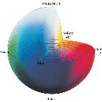
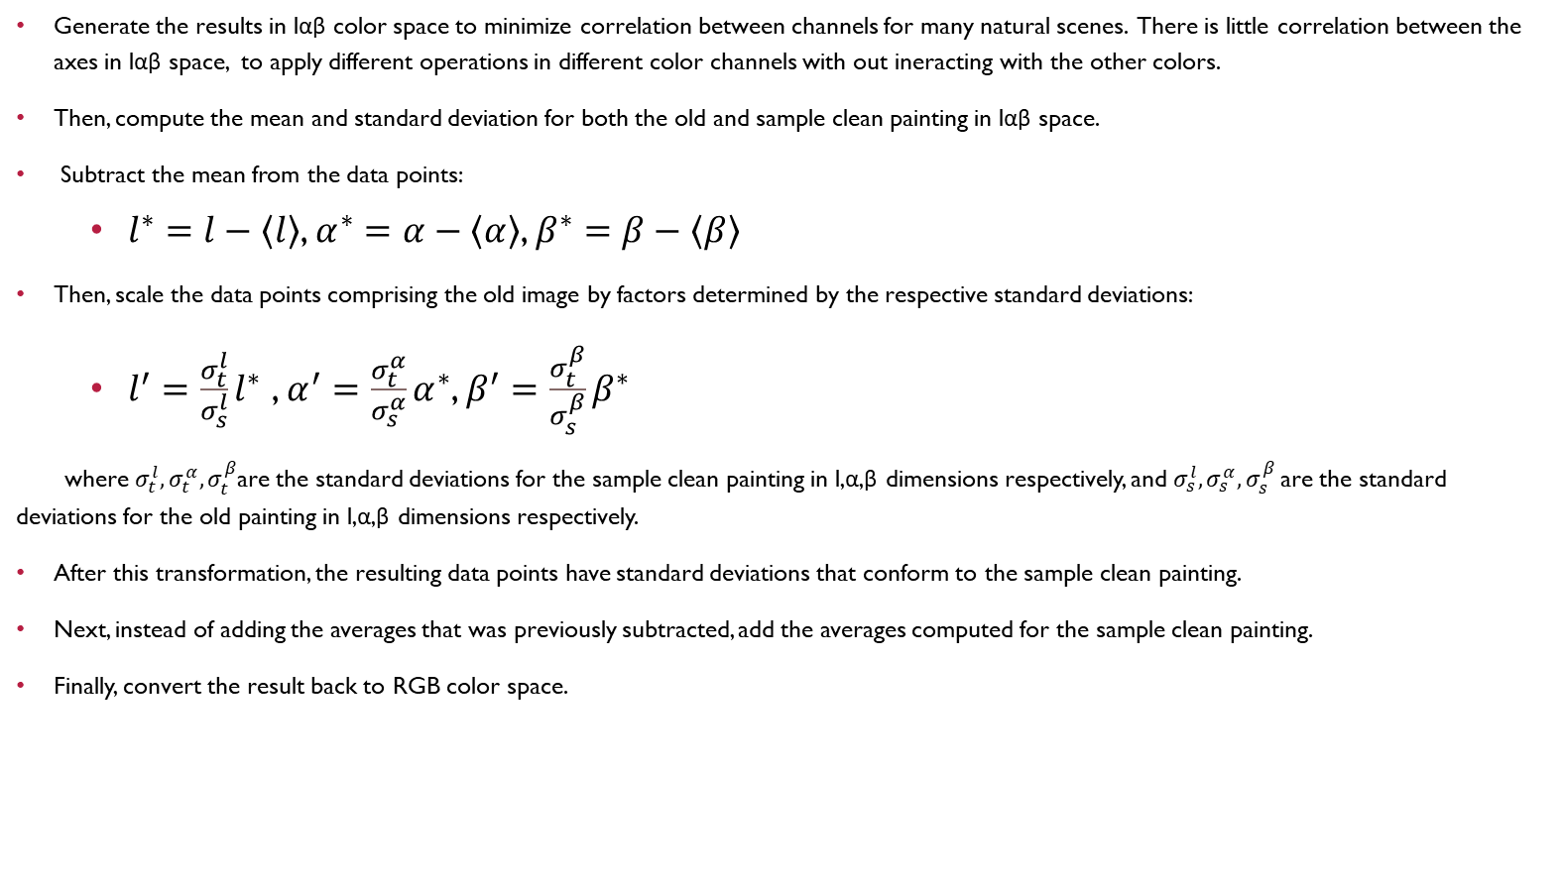
Generating results
Generate the results in lαβ color space to minimize correlation between channels for many natural scenes. There is little correlation between the axes in lαβ space, to apply different operations in different color channels with out ineracting with the other colors.
Then, compute the mean and standard deviation for both the old and sample clean painting in lαβ space.
Subtract the mean from the data points:
$l^{∗}=l−\left\langle l\right\rangle$, $α^{∗}=α−\left\langle α\right\rangle$, $β^{∗}=β−\left\langle β\right\rangle$
Then, scale the data points comprising the old image by factors determined by the respective standard deviations:
$l^{′}=\frac{σ_{t}^{l}}{σ_{s}^{l}}l^{∗}$ , $α^{′}=\frac{σ_{t}^{α}}{σ_{s}^{α}}α^{∗}$, $β^{′}=\frac{σ_{t}^{β}}{σ_{s}^{β}}β^{∗}$
where $σ_{t}^{l},σ_{t}^{α},σ_{t}^{β}$are the standard deviations for the sample clean painting in l,α,β dimensions respectively, and $σ_{s}^{l},σ_{s}^{α},σ_{s}^{β}$are the standard deviations for the old painting in l,α,β dimensions respectively.
After this transformation, the resulting data points have standard deviations that conform to the sample clean painting.
Next, instead of adding the averages that was previously subtracted, add the averages computed for the sample clean painting.
Finally, convert the result back to RGB color space.

Slide 13
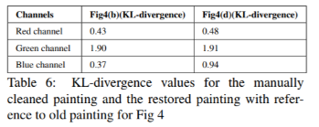
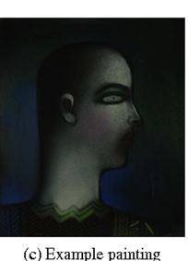
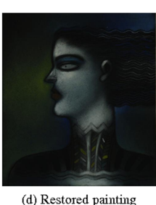
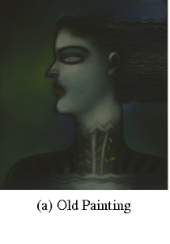
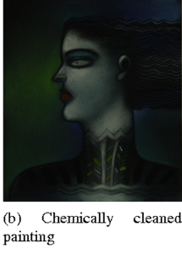
a)Old
b)Chemically cleaned
c)Example
d)Restored
Notes:
Here I have 4 different paintings, the original old painting needing to be restored, the chemically cleaned & restored version of the original painting, an example sample painting used for recoloring the digitally restored painting, and the digitally restored painting. Testing the similarity matrix in the upper right hand side which shows the chemically cleaned painting to be a bit more similar to the original than the digitally restored version, it has lower divergence, can you guess which painting is which?
Click to Reveal
Example is actually flipped, so position of the paint doesn’t matter, just overall color distribution of the sample is important.

Slide 14
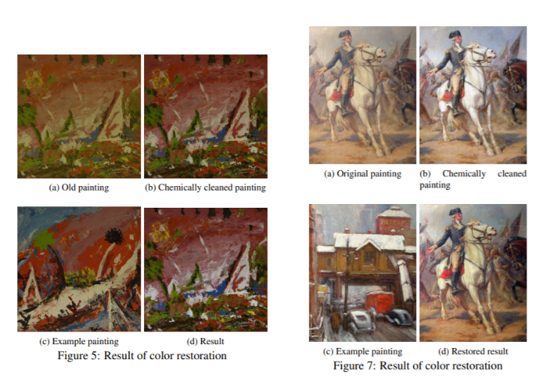
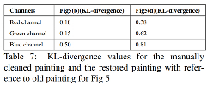
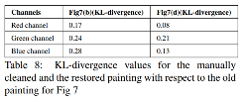
Example-based recoloration with different example pictures
Notes:
The sample paintings used for the digital restoration of these images were not copies of the original, but their own painting.
Zoom on a & c on left
Zoom in on table
For figure 5, the chemically cleaned painting has lower divergence from the original painting than the digitally restored one using the example painting, for all color channels, you can see the chemically cleaned one still has that amber coloration with muted colors, where as d has much more vivid colors, leading to increased divergence in all channels.
Go to right
Even though the sample painting is way more different subject wise, the divergence for the digitally restored painting is smaller than the chemically cleaned one, although the chemically clean one may be more alike to what the painting looked like when it was painted.

Slide 15
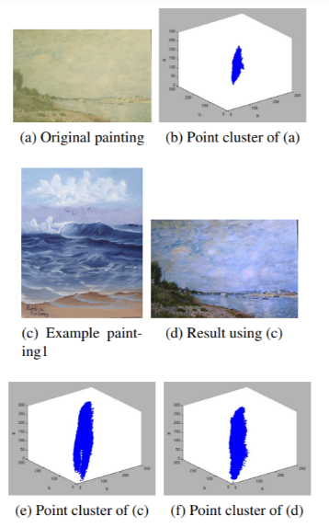
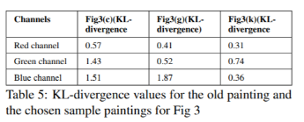
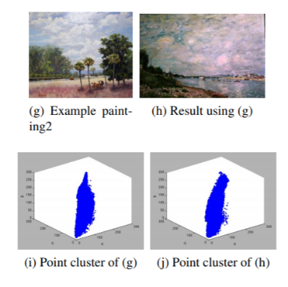
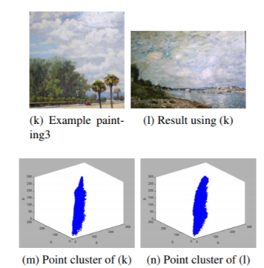
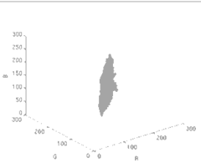
SAME PAINTING RECOLORED WITH DIFFERENT EXAMPLE PAINTINGS
Notes:
C being a painting of the blue ocean causes the sky to be a lot more blue and the point cluster shows that
The red on the sand shows up int the clouds.
Cropping g to not include the dark tree in the forefront and red shadows on the sand makes the restored painting using k much more similar to the original

Slide 16
Other applications of K-L divergence
And Applications of previously mentioned concepts to art restoration

Slide 17
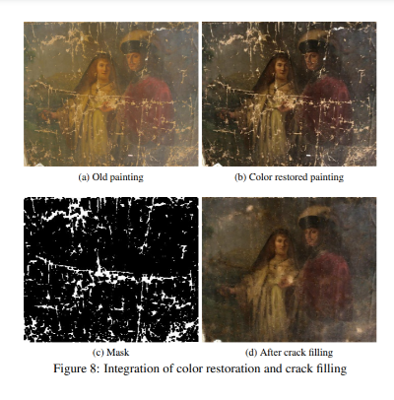
Another usage of neural networks: Identifying brush strokes & cracks
Notes:
A throwback to Annette’s neural networks presentation, we can use a neural network to identify cracks and brush strokes to be inpainted. The Minimal Radial Basis Function (MRBF) neural network [ZV09], after its training phase, becomes capable of deciding whether the pixel area in the original image belongs to a brush stroke or a crack.

Slide 18
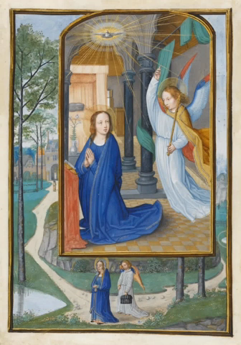
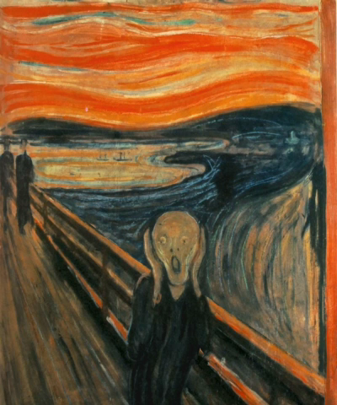
3d conservation Unveiling the invisible (Calatroni,..)
Step 1: Generate rough 3d model of scene with plausible parameters.
Step 2: Generate masks for all objects in painting(by hand or segmentation)
Step 3: Project masks onto 3d model and project original image as texture onto objects.
Step 4: Add virtual cameras
Step 5: Inpaint what was hidden from view in original scene.
The Scream, by Edvard Munch
Annunciation, by Simon Bening
Notes:
Besides 2d restoration, art conservators are also exploring 3d restoration projects
A mask is an area of your model that is ‘shielded’ from sculpting, painting
Segmentation covered in Callie’s unwrapping history presentation

Slide 19
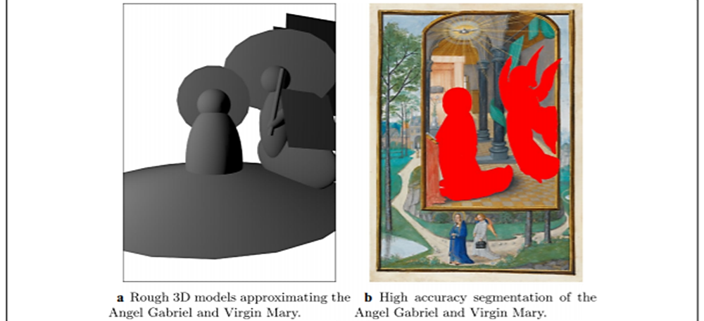
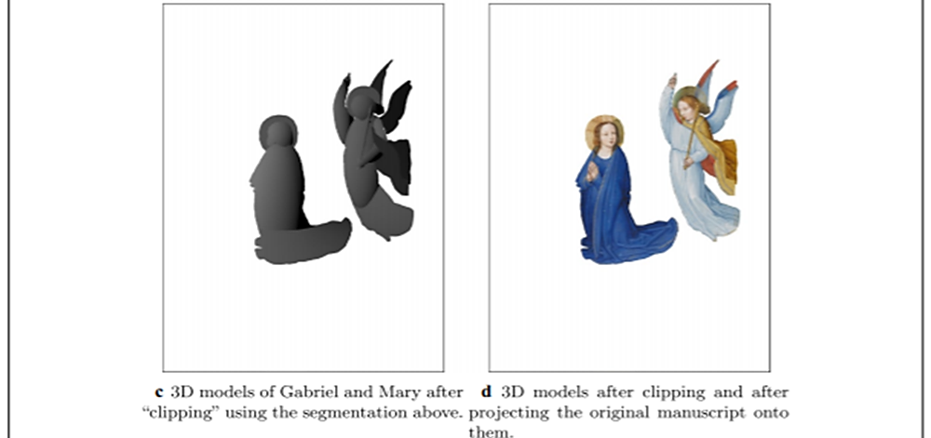
Notes:
A shows a rough 3d model of the two subjects
B shows the masking and segmentation of the subjects in the original
C shows how the models have been clipped down after the projection of the segmentation
D shows the 3d models after texture projection

Slide 20
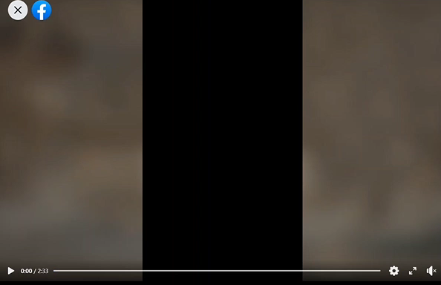
The British Museum: Hutong Gallery’s
“Reading in the Autumn Mountains”,
By Xiang Shenmo (項聖謨)
Notes:
On the British museum’s webpage and their facebook they have this video of the 3d conservation of Xiang Shengmo’s Reading in the Autumn mountains which I have sped up and added backround music for our viewing pleasure.

Slide 21
Bibliography
Baumgartner, Julian, director. Big Isn't Better, It's Just Better; The Restoration of St. Francis, 13 Jan. 2020, www.youtube.com/watch?v=jHcKBJ4sXEc
Brommelle, Norman Spencer, and Frank Zuccari. “Art Conservation and Restoration.” Encyclopædia Britannica, Encyclopædia Britannica, Inc., 2 June 2017, http://www.britannica.com/art/art-conservation-and-restoration
Calatroni, L., d’Autume, M., Hocking, R. et al. Unveiling the invisible: mathematical methods for restoring and interpreting illuminated manuscripts. Herit Sci 6, 56 (2018). https://doi.org/10.1186/s40494-018-0216-z https://heritagesciencejournal.springeropen.com/articles/10.1186/s40494-018-0216-z
“Conservation of Oil Paintings on Paper. From Ideas to Practical Solutions on the Example of Paintings by Estonian Artist Ado Vabbe.” Renovatum Anno, 5 Feb. 2019, https://renovatum.ee/en/autor/conservation-oil-paintings-paper-ideas-practical-solutions-example-paintings-estonian-artist
Daubechies, Ingrid. “Using Mathematics to Repair a Masterpiece.” Quanta Magazine, 29 Sept. 2016, www.quantamagazine.org/using-mathematics-to-repair-a-masterpiece-20160929/
N. Arora, A. Kumar, and P. Kalra. Digital restoration of old paintings. In International Conference in Central Europe on Computer Graphics, Visualization and Computer Vision (WSCG), June 2012, http://wscg.zcu.cz/WSCG2012/short/E61-full.pdf
Seery, Michael. “Paper Conservation.” RSC Education, 1 Mar. 2013, edu.rsc.org/feature/paper-conservation/2020204.article

